Slide 1

Balanced scorecard slide 1
https://github.com/Saheer7/polynomial-regression
POLYNOMIAL
REGRESSION
Regression analysis in which the relationship between the independent variable x and the dependent variable y is modelled as an nth degree polynomial in x
NAME: SAHEER
ROLL: D18019
PRAXIS BUSINESS SCHOOL

Slide 2
Balanced scorecard slide 2
Title of Database: Abalone data
Predicting the age of abalone from physical measurements. The age of abalone is determined by cutting the shell through the cone, staining it, and counting the number of rings through a microscope -- a boring and time-consuming task. Other measurements, which are easier to obtain, are used to predict the age. Further information, such as weather patterns and location (hence food availability) may be required to solve the problem.
Number of Instances: 4177
Number of Attributes: 8
Attribute information: Given is the attribute name, attribute type, the measurement unit and a brief description. The number of rings is the value to predict: either as a continuous value or as a classification problem.
Independent Variable we considered: ‘Diameter’ ( As High Correlation and R-Square with the Target)
http://archive.ics.uci.edu/ml/machine-learning-databases/abalone/abalone.names

Slide 3
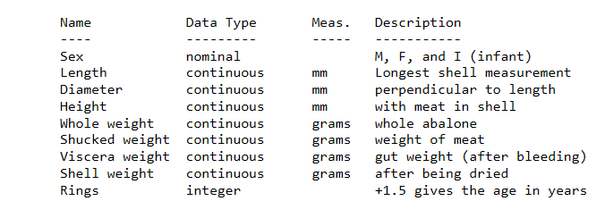
Attribute Information:
Missing Attribute Values: None
Target Attribute: Rings
http://archive.ics.uci.edu/ml/machine-learning-databases/abalone/abalone.names

Slide 4
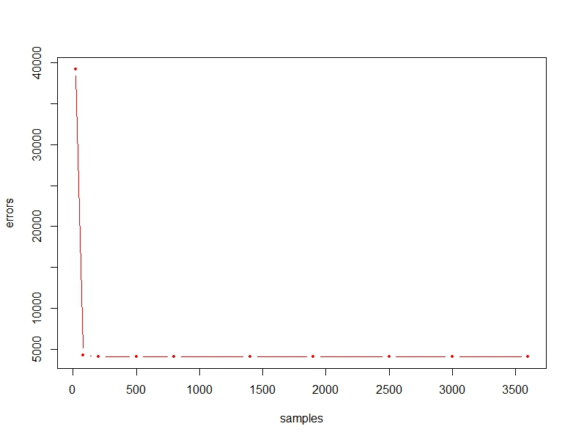
Balanced scorecard slide 3
Different Sample size VS RSS (of Degree 7):
Dependent Variable: Rings
Independent Variable: Diameter
SAMPLE SIZE
20 80 200 500 800 1400 1900 2500 3000 3600
RSS
39221.547 4272.766 4139.296 4115.158 4133.567 4110.077 4128.800 4127.861 4119.986 4124.982
https://github.com/Saheer7/polynomial-regression/blob/master/polynomial.R

Slide 5
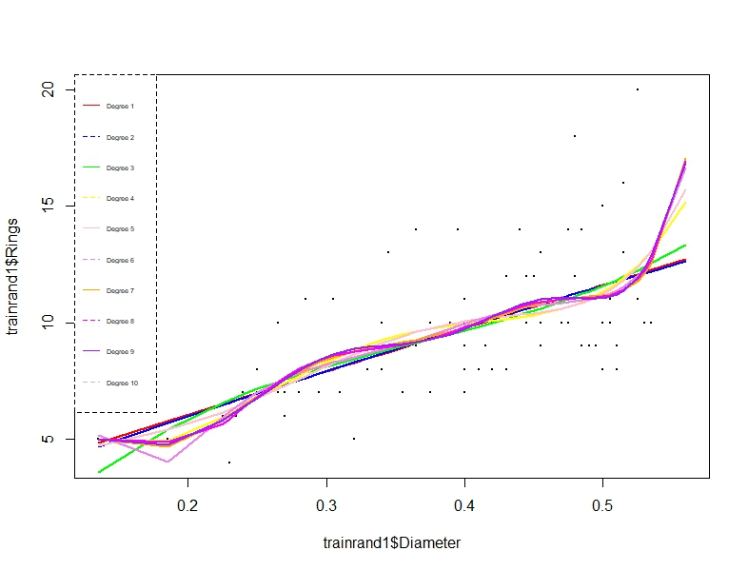
Comparing Regression lines(Degree 1-9)
Degree: 1,2,3,4,5,6,7,8,9,10 Sample Size: 78
https://github.com/Saheer7/polynomial-regression/blob/master/poly2.R

Slide 6
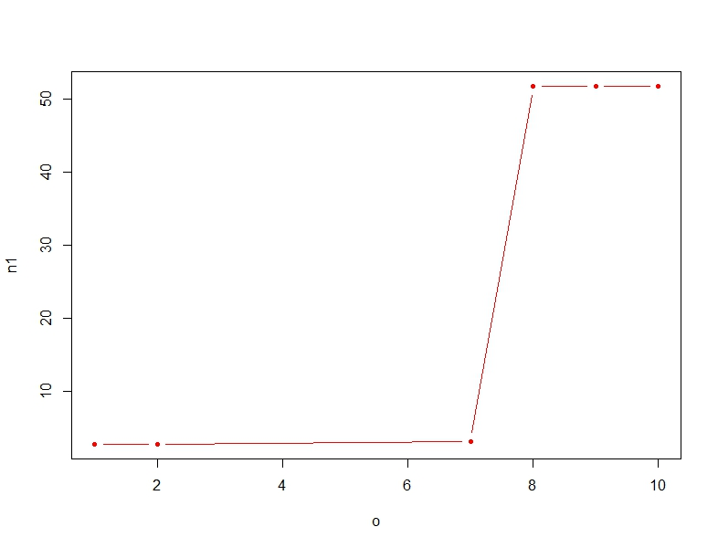
RMSE VS MODEL COMPLEXITY (Random)
Degree: 1,2,7,8,9,10 Sample Size: 70 Seed: 0
On X-Axis
O: Degree
On Y-Axis
n1: RMSE
DEGREE
1 2 7 8 9 10
RMSE
2.736871 2.725765 3.106083 51.752646 51.820416 51.820416
https://github.com/Saheer7/polynomial-regression/blob/master/poly3.R

Slide 7
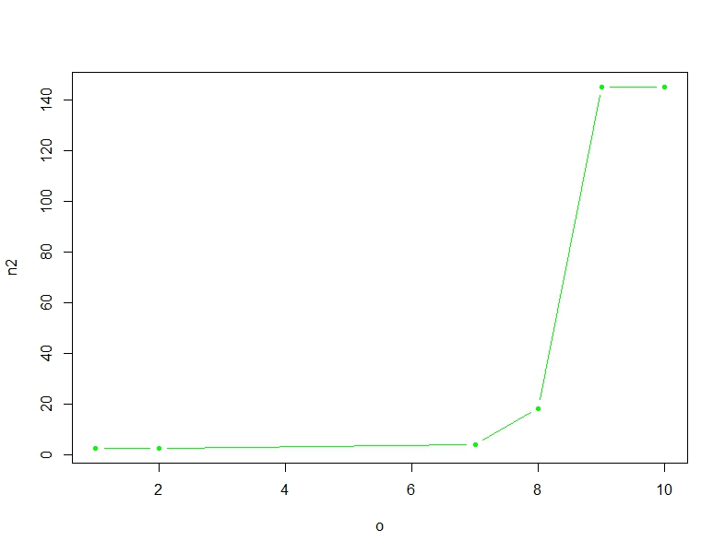
RMSE VS MODEL COMPLEXITY (Random)
Degree: 1,2,7,8,9,10 Sample Size: 70 Seed: 78
On X-Axis
O: Degree
On Y-Axis
n2: RMSE
DEGREE
1 2 7 8 9 10
RMSE
2.655057 2.665155 4.136517 18.422511 145.219596 145.219608

Slide 8
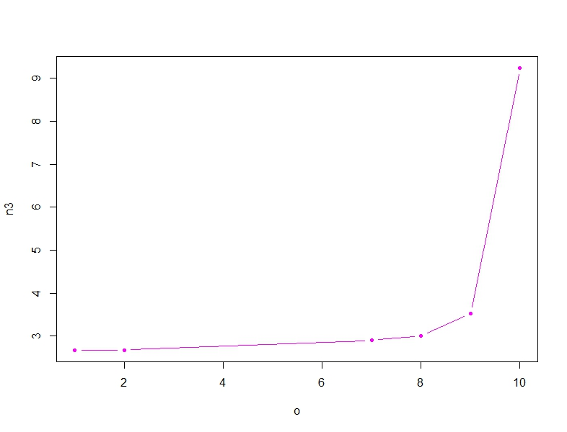
RMSE VS MODEL COMPLEXITY (Random)
Degree: 1,2,7,8,9,10 Sample Size: 70 Seed: 378
On X-Axis
O: Degree
On Y-Axis
n3: RMSE
DEGREE
1 2 7 8 9 10
RMSE
2.674783 2.676372 2.903662 3.003955 3.523457 9.237849

Slide 9
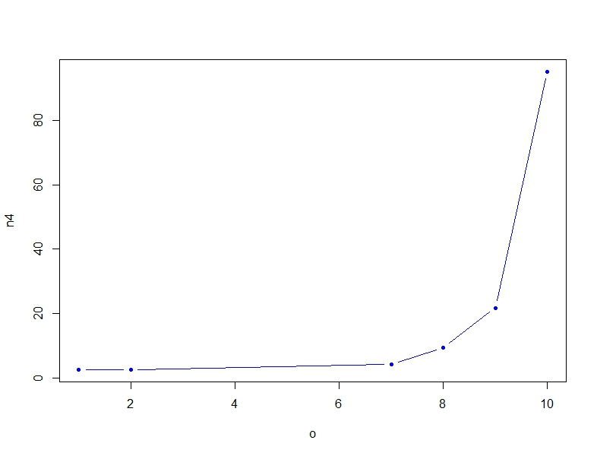
RMSE VS MODEL COMPLEXITY (Random)
Degree: 1,2,7,8,9,10 Sample Size: 70 Seed: 1687
On X-Axis
O: Degree
On Y-Axis
n4: RMSE
DEGREE
1 2 7 8 9 10
RMSE
2.722037 2.713431 4.353540 9.580999 21.839079 94.975353

Slide 10
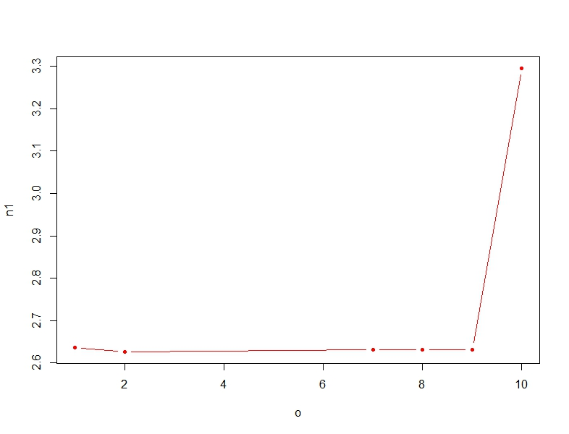
RMSE VS MODEL COMPLEXITY (Random)
Degree: 1,2,7,8,9,10 Sample Size: 800 Seed: 0
On X-Axis
O: Degree
On Y-Axis
n1: RMSE
DEGREE
1 2 7 8 9 10
RMSE
2.636352 2.626604 2.630827 2.630803 2.631790 3.295319
https://github.com/Saheer7/polynomial-regression/blob/master/poly4.R

Slide 11
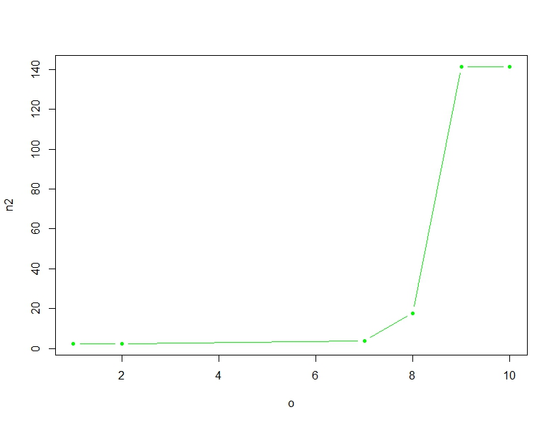
RMSE VS MODEL COMPLEXITY (Random)
Degree: 1,2,7,8,9,10 Sample Size: 800 Seed: 78
On X-Axis
O: Degree
On Y-Axis
n2: RMSE
DEGREE
1 2 7 8 9 10
RMSE
2.390570 2.400257 3.869397 17.774907 141.446890 141.446890

Slide 12
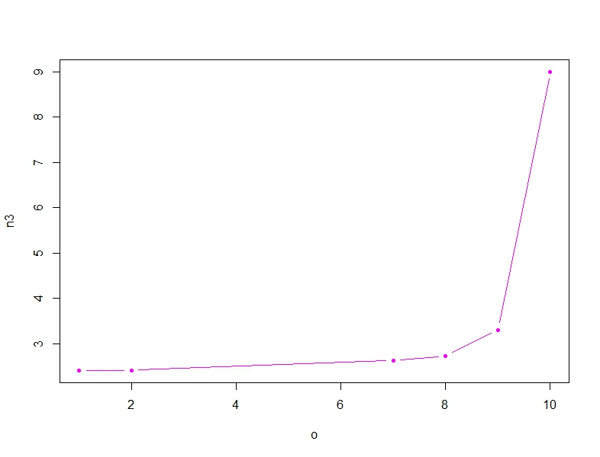
RMSE VS MODEL COMPLEXITY (Random)
Degree: 1,2,7,8,9,10 Sample Size: 800 Seed: 378
On X-Axis
O: Degree
On Y-Axis
n3: RMSE
DEGREE
1 2 7 8 9 10
RMSE
2.404973 2.406416 2.626468 2.728241 3.302475 9.002460

Slide 13
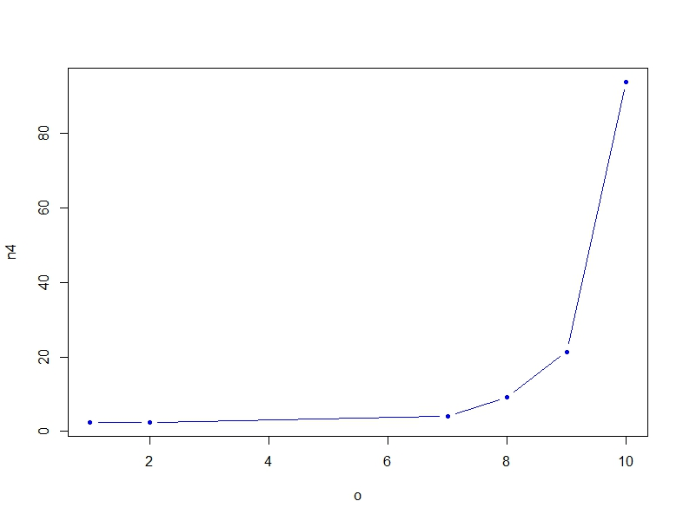
RMSE VS MODEL COMPLEXITY (Random)
Degree: 1,2,7,8,9,10 Sample Size: 800 Seed: 1687
On X-Axis
O: Degree
On Y-Axis
n4: RMSE
DEGREE
1 2 7 8 9 10
RMSE
2.451641 2.443948 4.068382 9.210899 21.377103 93.765662

Slide 14
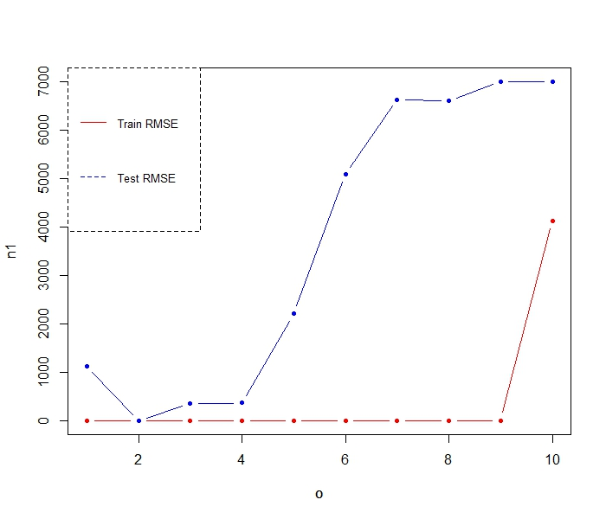
Train RMSE VS TEST RMSE
Degree: 1,2,3,4,5,6,7,8,9,10 Sample Size: 600
On X-Axis
O: Degree
On Y-Axis
n1: RMSE
1 2 3 4 5 6 7 8 9 10
DEGREE
RMSE TRAIN
2.59518 2.59141 2.58979 2.58516 2.56810 2.55926 2.55623 2.55622 2.55493 4124.981541
RMSE TEST
2.64641 2.63804 2.64066 2.64076 2.65450 2.67599 2.68750 2.68731 2.69026 2.69026
https://github.com/Saheer7/polynomial-regression/blob/master/poly5.R

Slide 15
Balanced scorecard slide 4
OBSERVATIONS
Different Sample size VS RSS (of Degree 7):
As sample size increases, Test error decreases
Comparing Regression lines(Degree 1-9):
As order increases, we can see the model overfits
RMSE VS MODEL COMPLEXITY (Random):
There is a pattern between test errors for different ‘random’ samples and different ‘sizes’ of samples
Train RMSE VS TEST RMSE:
Test RMSE is always greater than train RMSE

Slide 16
Balanced scorecard slide 10
PRAXIS BUSINESS SCHOOL
THANK YOU
PRAXIS BUSINESS SCHOOL

